Slide 1

Advance NLP : Hate Speech detection using Transformers
Michael Udonna Egbuzobi and Nweke Nonye
31-October-2024

Slide 2

Agenda
Problem Statement
Dataset Summary
Data Preprocessing
Exploratory Data Analysis
Model Selection
Model Training & Evaluation Matrics
Comparison of Model Performance
Recommendation
Conclusion
Team Members
Link to repository

Slide 3
Problem Statement
Hate speech is a form of communication that uses derogatory language to attack or discriminate against individuals.
Detecting hate speech online is crucial for maintaining healthy social interactions, particularly on platforms like Twitter, where information spreads quickly.
The aim of this project is to develop an advanced hate speech detection model using transformer-based deep learning architectures. The model will classify text (tweets) into hate speech or non-hate speech (binary classification).

Slide 4
Dataset Summary
The dataset can be accessed at the following link: https://www.kaggle.com/vkrahul/twitter-hate-speech?select=train_E6oV3lV.csv. It includes labelled Twitter data, with tweets classified as hate speech (label: 1) or non-hate speech (label: 0), specifically prepared for hate speech detection research
The dataset consists of two files:
Train Data which consists of 31,962 observations and 3 features
Test Data which consists of 17,197 observations and 2 features

Slide 5
Data Preprocessing
TEXT CLEANING: Used regular expressions (regex) to clean the text by removing URLs, and special characters, and converting all text to lowercase. This ensured consistent input for the model and reduced noise in the data.
TOKENIZATION: Applied BERT tokenizer to split the cleaned text into tokens (small units) and convert them into numerical representations. This step enabled BERT to understand the context and meaning of each tweet effectively.

Slide 6
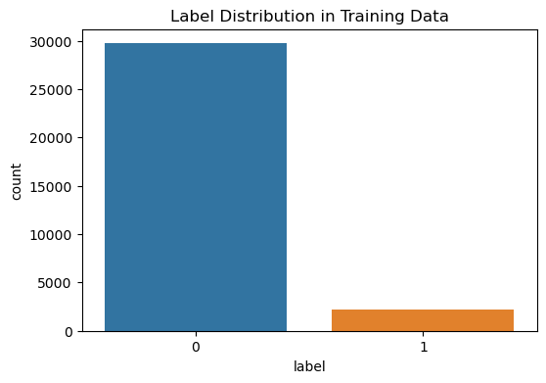
Exploratory Data Analysis
We initiated our analysis by assessing the distribution of labels and identified an imbalance in the dataset. To address this, We applied class weights in Transformers and Logistic Regression to emphasize the minority class and used scale_pos_weight in XGBoost to address the imbalance effectively

Slide 7
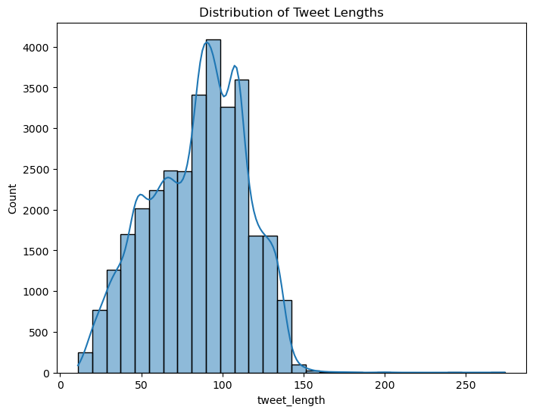
Exploratory Data Analysis
Next, we analyzed the distribution of tweet lengths and observed a left-skewed pattern, further indicating the presence of data imbalance.

Slide 8
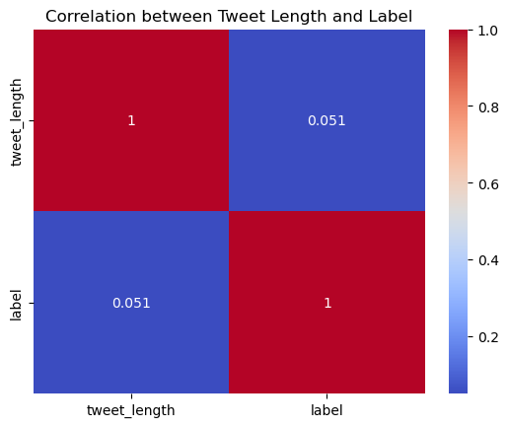
Exploratory Data Analysis
Correlation Analysis: A low correlation (0.051) was found between tweet length and hate speech, indicating that tweet length does not significantly predict the presence of hate speech.

Slide 9
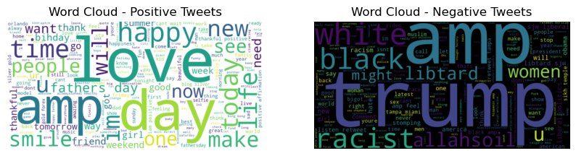
Exploratory Data Analysis
Word Cloud Analysis:
Hate Speech Keywords: Common terms include "trump", "black", "racist", "liptard", and "amp".
Non-Hate Speech Keywords: Terms such as "love", "happy", "smile", and "day" were frequently found in non-hate speech tweets.

Slide 10
Model Selection
Chosen Models:
We used Transformers (BERT) as the primary model for classification due to its strong language understanding. Logistic Regression and XGBoost were included for comparison to assess model effectiveness.
Feature Representation
TF-IDF vectorization was applied for Logistic Regression and XGBoost, while the BERT tokenizer transformed text data into context-aware embeddings for the Transformer model.

Slide 11
Model Training and Evaluation Matrics
Training and Testing Setup:
Data was split into 80% training and 20% testing sets to ensure fair evaluation.
Evaluation Metrics:
We measured accuracy, precision, recall, and F1-score to assess each model. F1-score and recall were prioritized for capturing hate speech accurately.

Slide 12
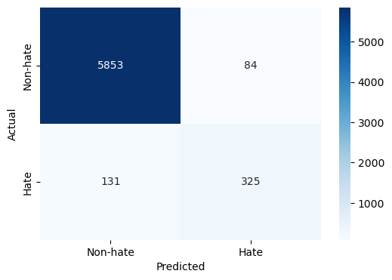
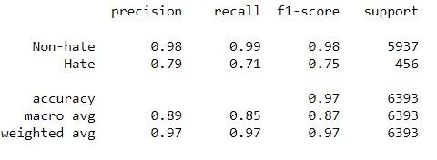
Transformer Model
Performance Summary: The Transformer model achieved high accuracy (97%) with strong F1-scores across both classes, particularly excelling in non-hate detection.
Confusion Matrix: Showed balanced performance and low misclassification across classes.
Insights: This model provided high reliability and generalizability, performing well on both hate and non-hate speech.

Slide 13
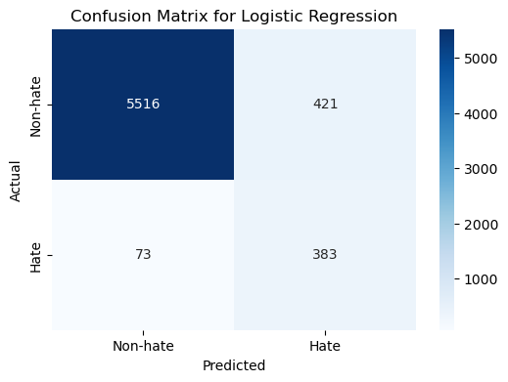
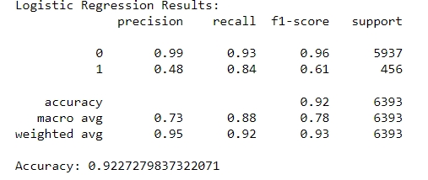
Logistic Regression Model
Performance Summary: Logistic Regression achieved high recall (84%) for hate speech, catching most hate tweets but with lower precision.
Confusion Matrix: Revealed high true positives for hate but also more false positives.
Insights: The model is sensitive to hate speech but tends to mislabel some non-hate tweets as hate.

Slide 14
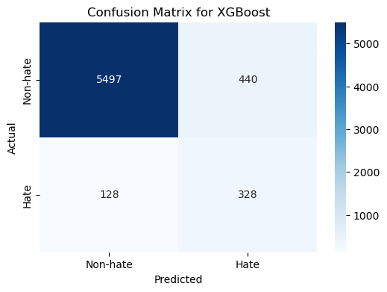
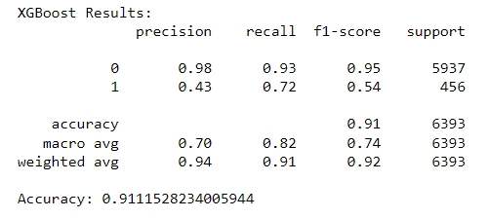
XGBoost Model
Performance Summary: XGBoost performed well on non-hate speech with high accuracy but struggled with lower recall and precision for hate speech..
Confusion Matrix: Showed lower accuracy in distinguishing hate tweets, with more false negatives..
Insights: XGBoost performed reliably for non-hate tweets but had limited effectiveness in hate speech detection due to lower sensitivity..

Slide 15
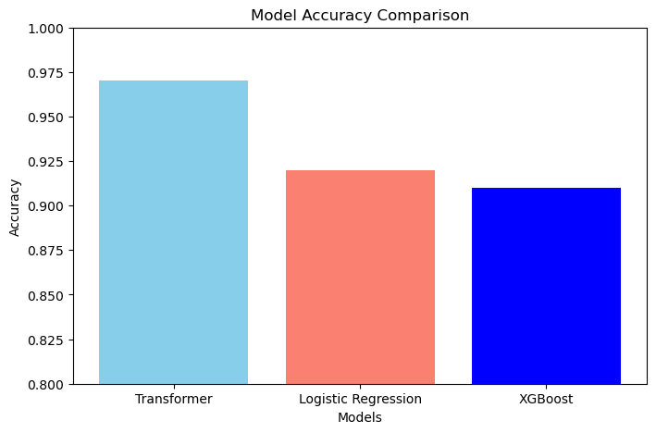
Comparison of Model Performance
Models were compared based on accuracy, F1-score, precision, and recall. The Transformer model emerged as the best performer across all metrics.
Transformers provided the most balanced and accurate results for both classes, making it the optimal choice for this project.
Model | Accuracy
Transformer | 97%
Logistic Regression | 92%
XGBoost | 91%

Slide 16
Recommendation
Based on overall performance, Transformers (BERT) is recommended for deployment due to its high accuracy and balanced detection across both classes.
Further improvements could include data augmentation, fine-tuning, and ensemble approaches to enhance model robustness. Testing on larger datasets and implementing real-time monitoring could also improve practical applications.

Slide 17
CONCLUSION
This project demonstrated the effectiveness of Transformers for hate speech detection, achieving high accuracy and balanced performance.

Slide 18
Team Members
Team member two:
Team member one:
Michael Udonna Egbuzobi
egbuzobi.michael@gmail.com
United Kingdom
University of Wolverhampton
Data Science
Nweke Nonye
nonyenweke22@gmail.com
United Kingdom
University of Wolverhampton
Data Science

Slide 19
Link to Repository
https://github.com/UdonnaM/Advance-NLP-Hate-Speech-detection-using-Transformers-Deep-Learning-

Slide 20
Advance NLP : Hate Speech detection using Transformers
Thank You

